Slide 1
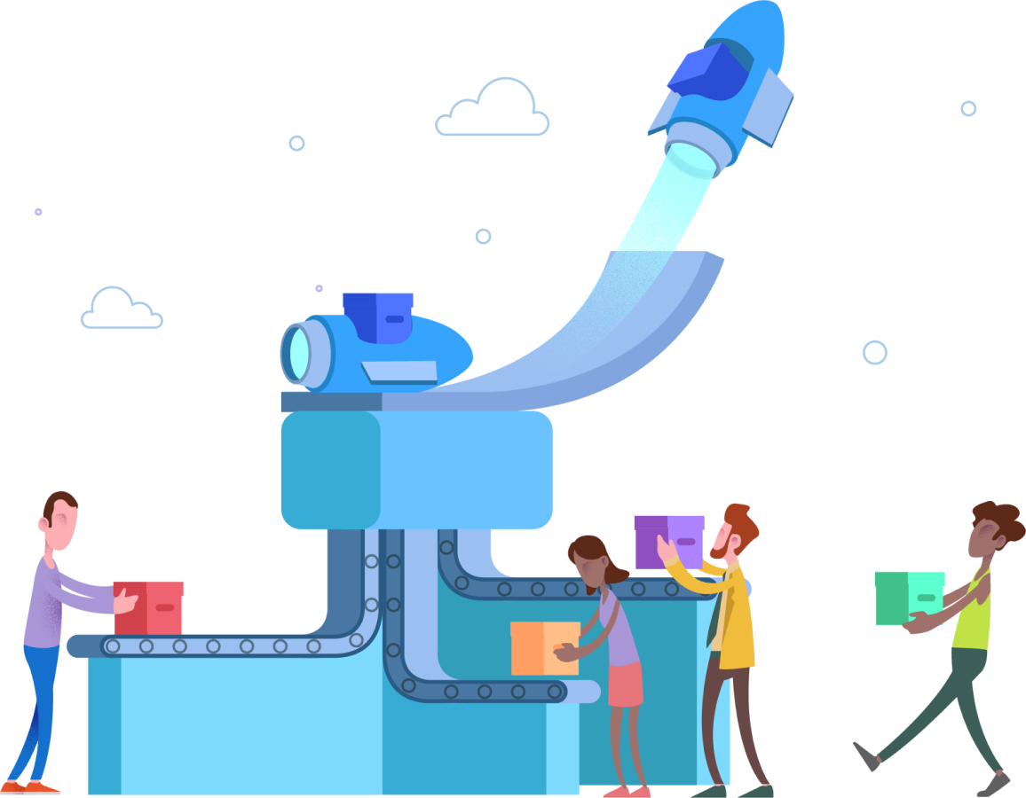
Courage in Chaos Microsoft Azure
Hardik Mistry
hardik@appmattic.com
@mistryhardik05

Slide 2



The challenges
Unavailability of the service
Poor customer retention
Impact of business/operations
Icon credits: https://www.flaticon.com/authors/nhor-phai
Notes:
These are some challenges which have impacted us in one way or another.
We generally do not like to talk and that leads to too many assumptions
Due to lack to clear communication and feedback we end up in a never ending dilemma of what the customer really wants and that makes us plan for things inefficiently
This collectively leads to slower Time to Market for your customer(s)

Slide 3
What is HA/DR?
An architecture implemented to overcome infrastructure issues
A policy to implement and follow in case of infrastructure issues
Notes:
Alright so here are some thoughts around why is DevOps important?
DevOps promises speed: delivering value to customers, reducing cycle time, faster time to market, shorter mean-time-to-resolution.

Slide 4
Why is HA/DR important?
Always available platform/service
Improved customer satisfaction
Reduced churn rate
Notes:
Alright so here are some thoughts around why is DevOps important?
DevOps promises speed: delivering value to customers, reducing cycle time, faster time to market, shorter mean-time-to-resolution.

Slide 5
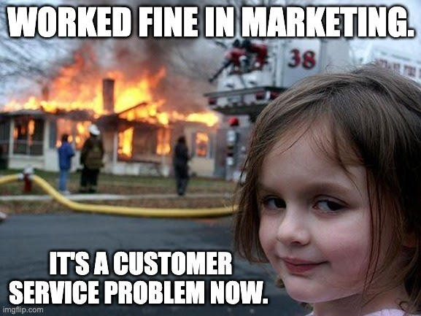
Notes:
Alright so here are some thoughts around why is DevOps important?
DevOps promises speed: delivering value to customers, reducing cycle time, faster time to market, shorter mean-time-to-resolution.

Slide 6
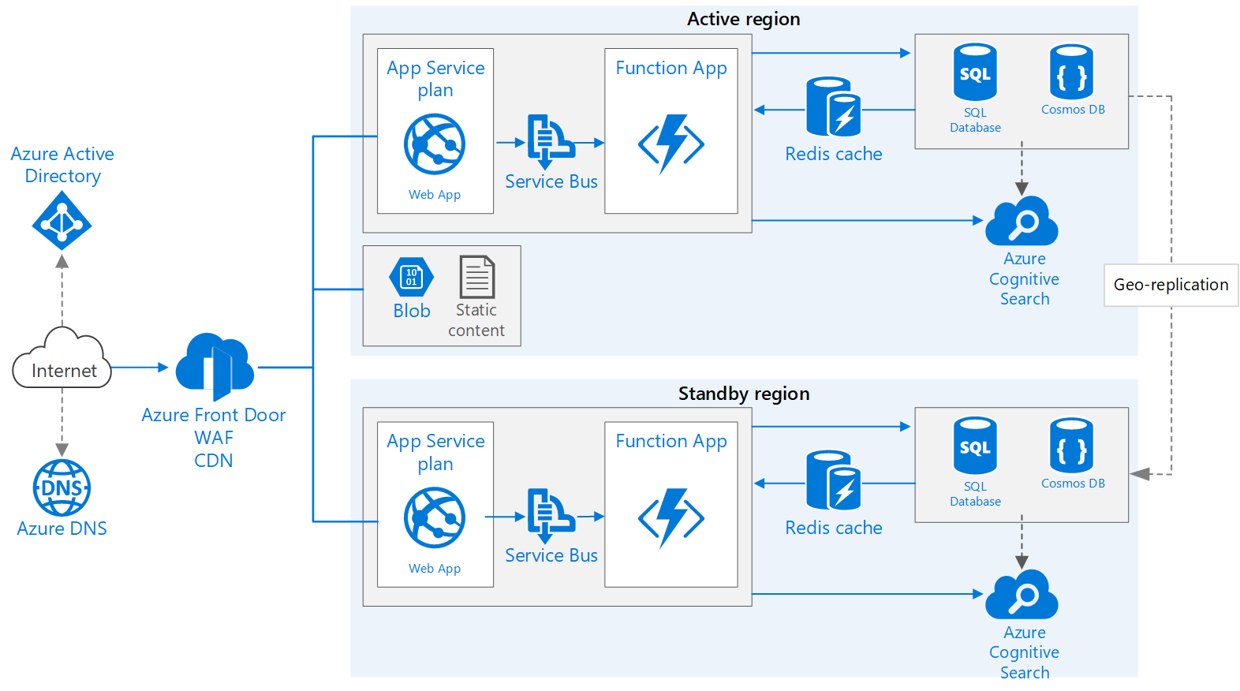
Overview
An ideal multi-region app architecture
Notes:
MS content: Highly available multi-region web app - Azure Architecture Center | Microsoft Learn

Slide 7
Monitoring
Setup alerts on your app-service or VM metrics
Avg. Memory consumption metric is your best friend.
Monitor using app insights or metrics blade of the resource.
Use load testing to understand app behaviour and tune to match expected SLA.
Setup dev/acceptance with robust monitoring
Limit monitoring on production apps to avoid bottlenecks
Notes:
Alright so here are some thoughts around why is DevOps important?
DevOps promises speed: delivering value to customers, reducing cycle time, faster time to market, shorter mean-time-to-resolution.

Slide 8
Resiliency on Azure
If you are serving HTTP traffic
Azure Front Door
Optionally setup fire wall to secure access
If you are serving traffic over HTTP, TCP or UDP protocol
Traffic Manager
DNS level load balancer
Is resilient to failure, including the failure of an entire Azure region.
https://bit.ly/az-load-balance
Notes:
Alright so here are some thoughts around why is DevOps important?
DevOps promises speed: delivering value to customers, reducing cycle time, faster time to market, shorter mean-time-to-resolution.

Slide 9
Resiliency on app service
Setup auto-scale for your VM or app services
Use monitoring tools to understand app performance and demand
Configure scale settings by CPU percentage or Memory consumption
Anticipate traffic during festivals or holidays and schedule scale beforehand.
https://bit.ly/az-auto-scale
Tip: Consider using 75% to 60 % as metric unit for a span of 10 mins to make sure the service can scale to meet high demand.
Notes:
Alright so here are some thoughts around why is DevOps important?
DevOps promises speed: delivering value to customers, reducing cycle time, faster time to market, shorter mean-time-to-resolution.

Slide 10
Resiliency...
Consider moving your SQL from VM to Azure SQL
Azure SQL is PaaS with built-in resiliency.
Configure Geo-replication [Azure SQL only] to restore quickly in case of DC outage
Tune the DTU or VCore scale as per your volume of data and traffic to serve
Start with DTU based pricing model, works great for most of us
Setup backup even if done manually to restore in point
https://bit.ly/az-sql-ha
Notes:
Alright so here are some thoughts around why is DevOps important?
DevOps promises speed: delivering value to customers, reducing cycle time, faster time to market, shorter mean-time-to-resolution.

Slide 11
Demo Resilient app service and auto-scale
Notes:
Link to MS content: https://learn.microsoft.com/en-us/azure/azure-monitor/autoscale/autoscale-get-started

Slide 12
Load testing
Use Load testing service from Azure
Cost friendly
No code testing service
Collect key insights on app performance
https://bit.ly/az-load-testing
Use availability testing using you are using app insights
https://bit.ly/az-insights-avail-testing
Notes:
Alright so here are some thoughts around why is DevOps important?
DevOps promises speed: delivering value to customers, reducing cycle time, faster time to market, shorter mean-time-to-resolution.

Slide 13
Demo Load testing app service

Slide 14
Extras
https://bit.ly/pls-az-wtu
Get the right perspective on what to use when on MS Azure
https://bit.ly/hm-az-reactor-pulumi
Session on using Pulumi as framework for IaC [Infrastructure as code]
Notes:
Alright so here are some thoughts around why is DevOps important?
DevOps promises speed: delivering value to customers, reducing cycle time, faster time to market, shorter mean-time-to-resolution.

Slide 15
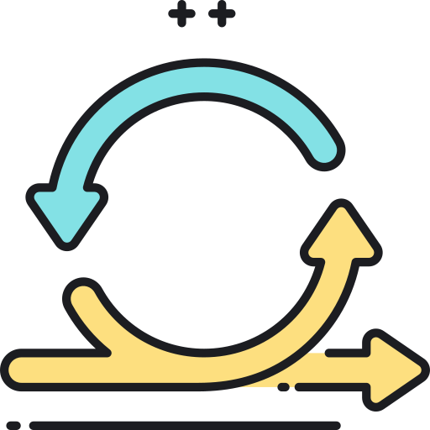


The summary
Automate infrastructure components with IaC
Monitor and load test proactively
Take actions beforehand
Icon credits: https://www.flaticon.com/authors/freepik
Icon credits: https://www.flaticon.com/authors/flat-icons
Notes:
Let’s summarize what we should be doing next
- Do not dig a well when you get thirsty, be proactive and have the readiness
Make use of communication tools and stay productive everyday
Make the stakeholder participate and deliver priority items first
To summarize
Alright, I hope this action packed demo gave you some insights on how would you try and deliver success for your customers.
Thank you for coming by, have a great day ahead

Slide 16
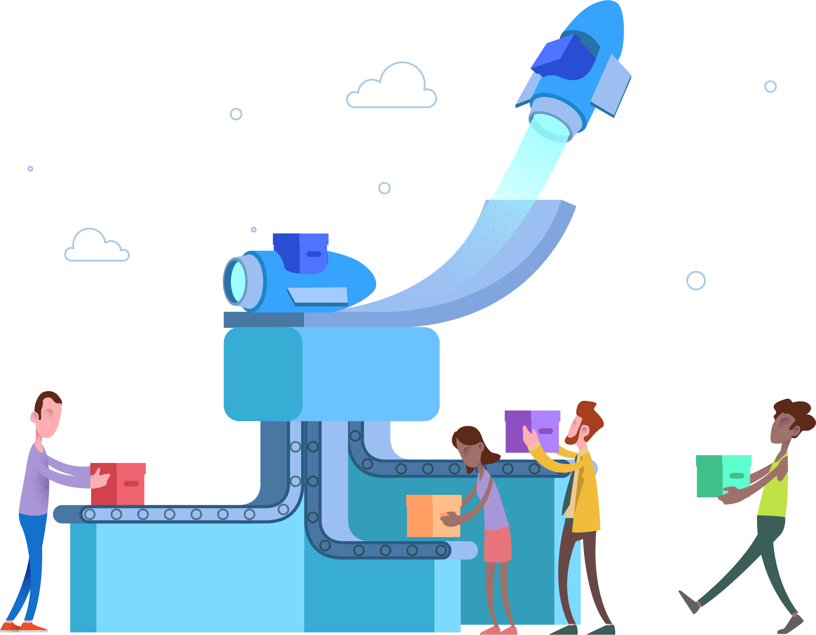

Thank you. Questions?
#GABMumbai2023
@mistryhardik05
https://bit.ly/gab-mum-chaos-2023
Notes:
Join the conversation.
Potentially replace for speaker contact details / intro.

